Slide 1


PROJECT REPORT
ON
Academia
Submitted By :
Brijesh Dhameliya (1141)
Akshay Ghoghari (1153)
Dhruv Godhani (1159)
Khushal Kaklotar (1182)
Guided By : Mr . Chetan Rathod

Slide 2
Index
Serial No. | Description
1 | Project Profile
2 | Project Introduction
3 | Hardware Requirement
4 | Software Requirement
5 | Scope
6 | Database Design
7 | Use Case Diagram(0 Level)
8 | Screen Layout
9 | References

Slide 3
Project Profile
Project Name : | Academia
Project Type : | Android Application
Duration : | 3 Month
Front-End-Tool : | Android Studio
Back-End-Tool : | Firebase
Other Tools : | Draw.io , IconScout ,Vecteezy
Team Size : | 4 Members
Guided By : | Mr . Chetan Rathod

Slide 4
Project Introduction
In the past when our application was not introduced teacher and principal have to work on the student’s information personally and it is taking too much time and paper work of teacher to generate the report of the student.
Principal had to give the information of the events and time table of the school in the school announcements system like mic, speaker to solve this type of problem we are announcing this Academia application
The main purpose of the app is to help the school and the Environment.

Slide 5
Hardware Requirement
Client Side :
RAM : 4 GB
Internet enabled android device
Server Side :
Disk Space : No Nedded space
Development Side :
Hard Disk : 500 GB
RAM : 8gb

Slide 6
Software Requirement
Client Side :
Installed Application
Server Side :
Fire Base
Development Side :
Operating System : Windows 10
Software : Android Studio
Browser (chrome)

Slide 7
Scope
MAIN ADMIN
(Principal)
ADMIN
(Teacher)
CLIENT
(Student)

Slide 8
Main Admin
Main Admin Can Registration
Main Admin Can Login
Main Admin Can Insert Teacher
Main Admin Can View Teacher
Main Admin Can Edit Teacher
Main Admin Can Delete Teacher
Main Admin Can View Student Attendance
Main Admin Can View Student Marksheet
Main Admin Can View Link
Main Admin Can View News
Main Admin Can View Book

Slide 9
Main Admin
Main Admin Can View Time-Table
Main Admin Can Edit profile
Main Admin Can View profile
Main Admin Can change password
Main Admin Can Logout

Slide 10
Admin
Admin Can Login
Admin Can Insert
Admin Can Insert Student
Admin Can View Student
Admin Can edit Student
Admin Can delete Student
Admin Can Insert Student Attendance
Admin Can view Student Attendance
Admin Can edit Student Attendance
Admin Can delete Student Attendance
Admin Can Insert Link

Slide 11
Admin
Admin Can Edit Link
Admin Can View Link
Admin Can Delete Link
Admin Can Insert News
Admin Can Edit News
Admin Can View News
Admin Can Delete News
Admin Can Insert Books
Admin Can Edit Books
Admin Can View Books
Admin Can Delete Books
Admin Can Insert Marksheet

Slide 12
Admin
Admin Can Edit Marksheet
Admin Can View Marksheet
Admin Can Delete Marksheet
Admin Can Insert Time-Table
Admin Can Edit Time-Table
Admin Can View Time-Table
Admin Can Delete Time-Table
Admin Can View Profile
In edit if name or phone number is changed then password is updated automatically else only details are changed not password
Admin Can change password
Admin Can Logout

Slide 13
Client
Client Can Login
Client Can View Attendance
Client Can View Links
Client Can View News
Client Can View Books
Client Can View Time-Table
Client Can View Marksheet
Client Can View Profile
Client Can Change Password
Client Can Logout

Slide 14
Use case Diagram
Use case for Main Admin (Principal)
Use case for Admin (Teacher)
Use case for Client (Student)

Slide 15
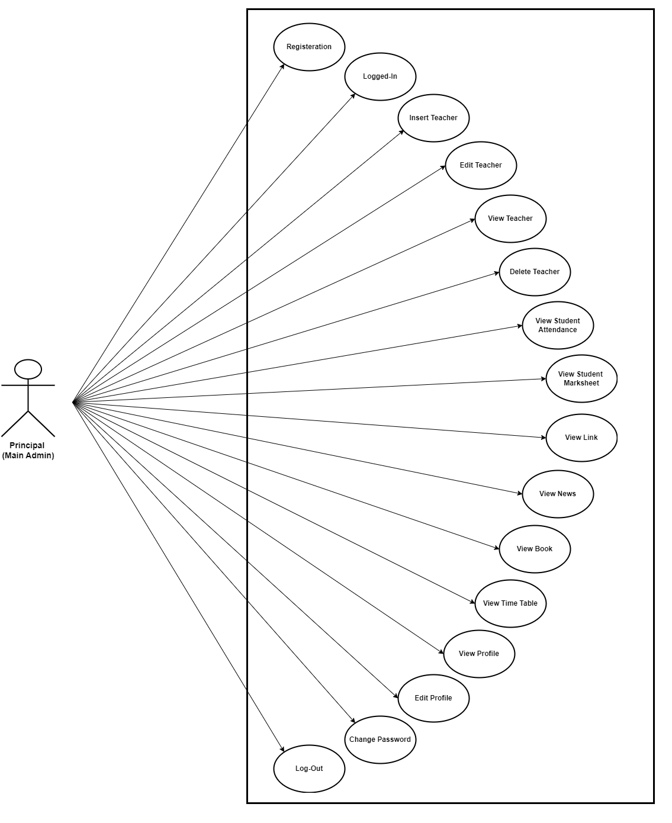

Slide 16
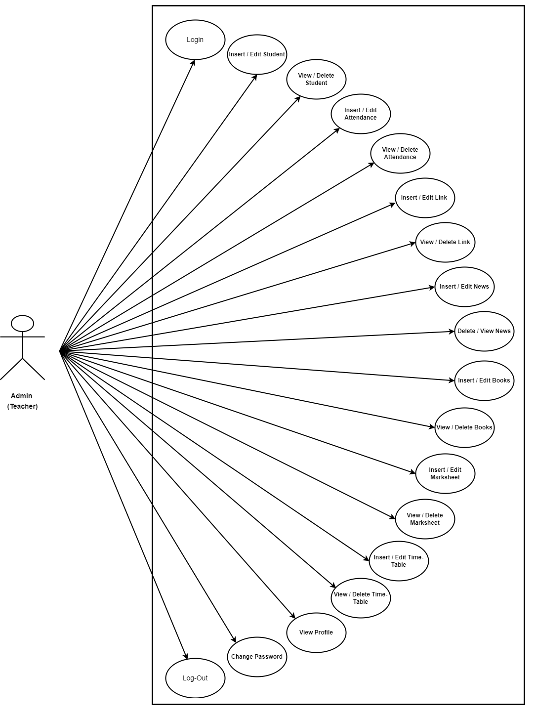

Slide 17
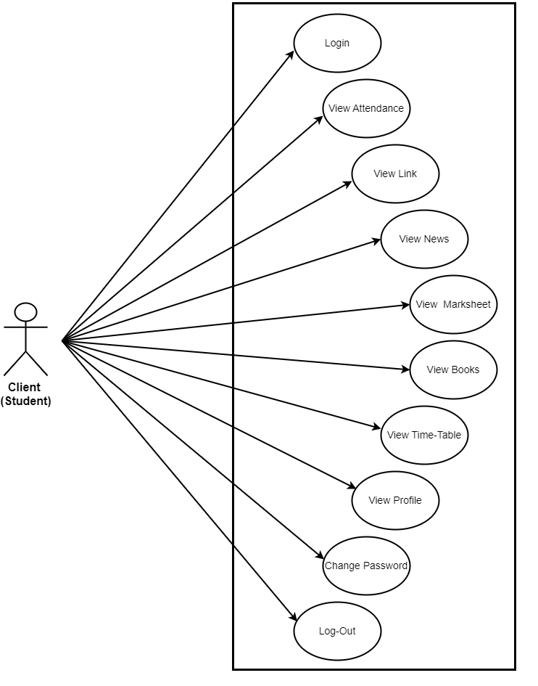

Slide 18
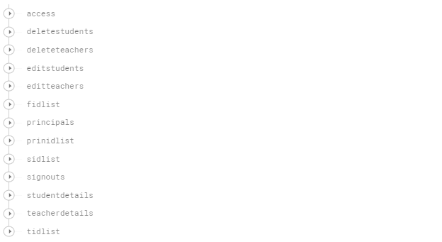
Database Design

Slide 19
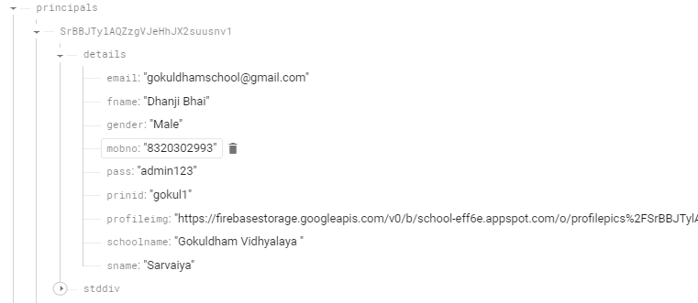

Slide 20
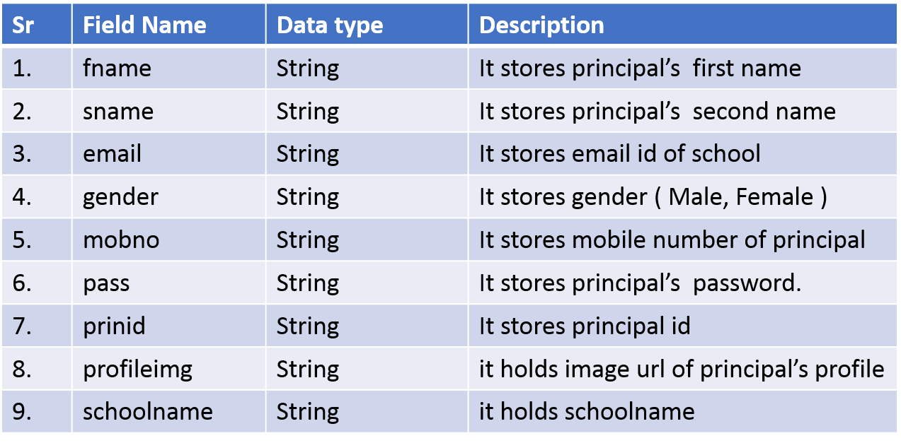

Slide 21
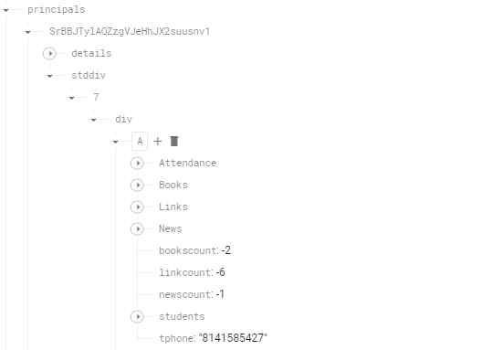

Slide 22
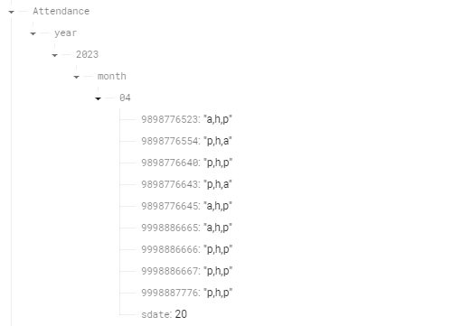

Slide 23
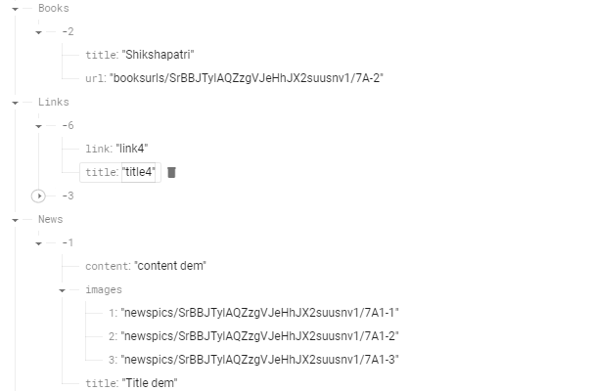

Slide 24
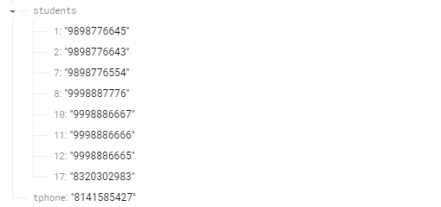

Slide 25
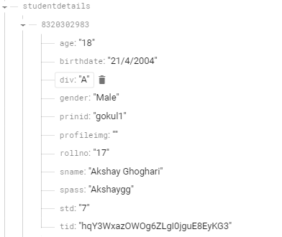
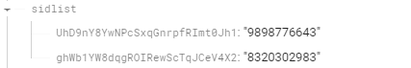

Slide 26
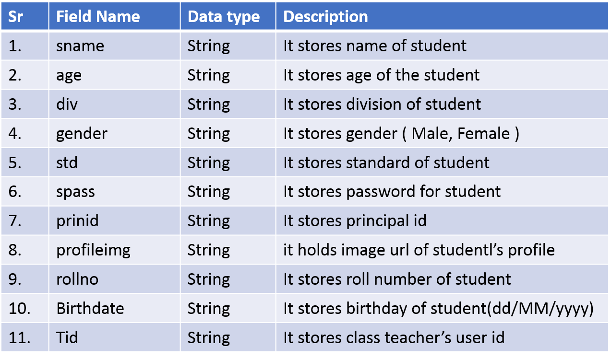

Slide 27
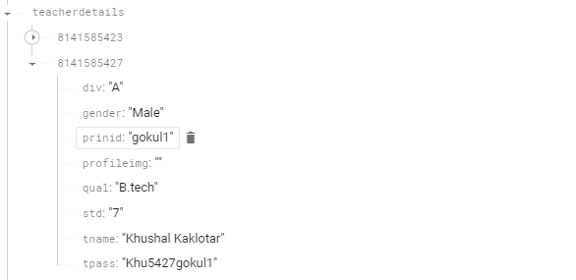
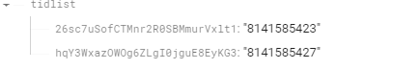

Slide 28
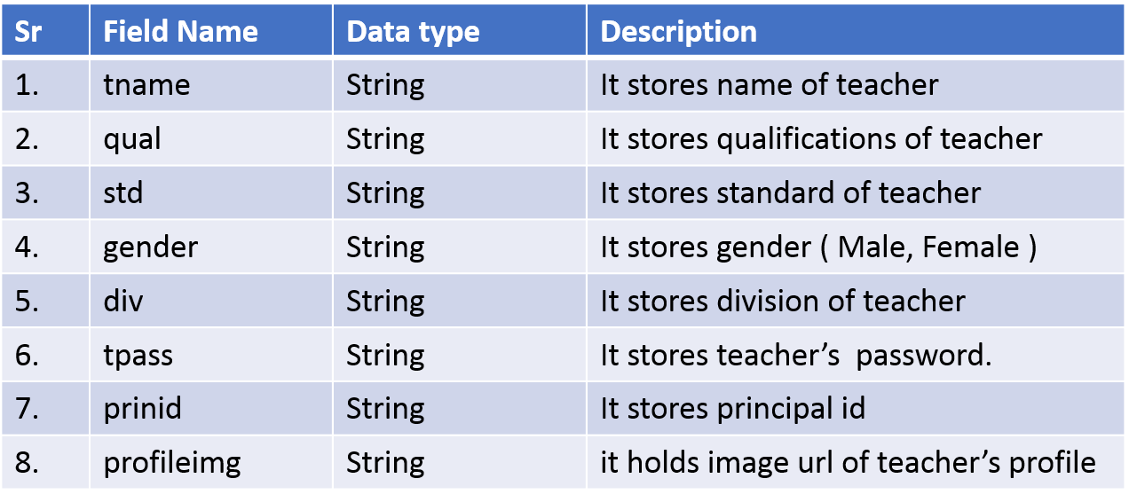

Slide 29
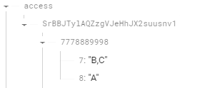
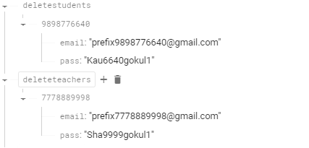

Slide 30
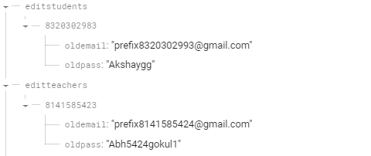
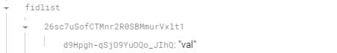
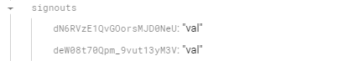

Slide 31
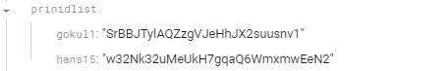
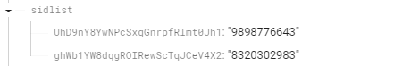
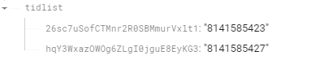

Slide 32
Screen Layout
Main Admin (Principal)
Admin (Teacher)
Client (Student)

Slide 33
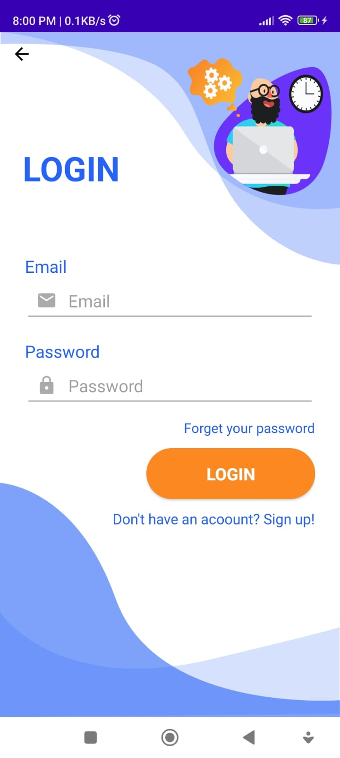
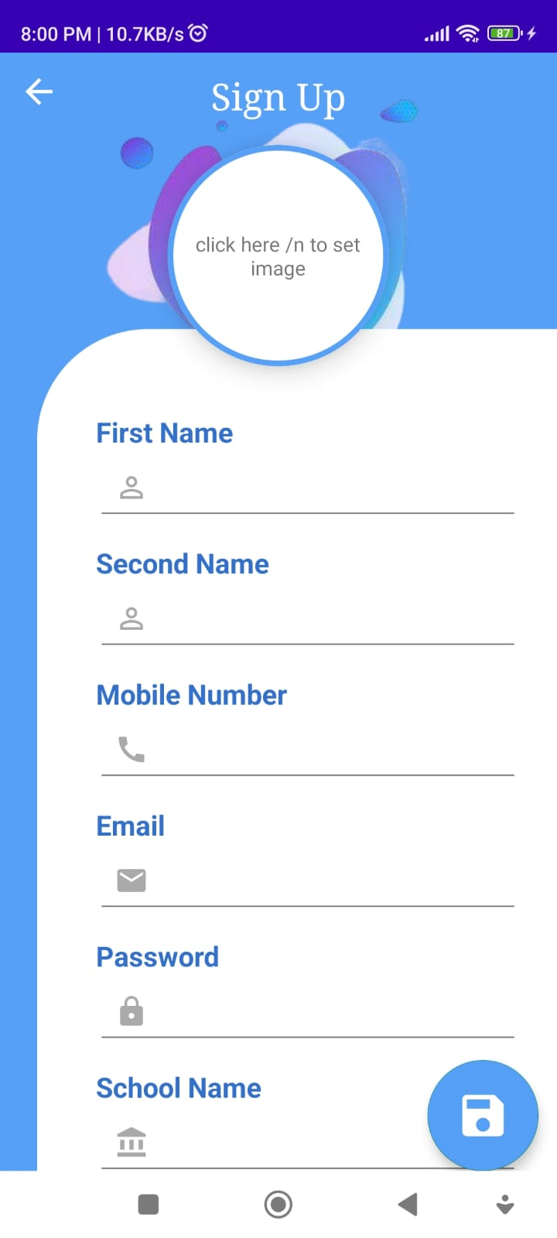
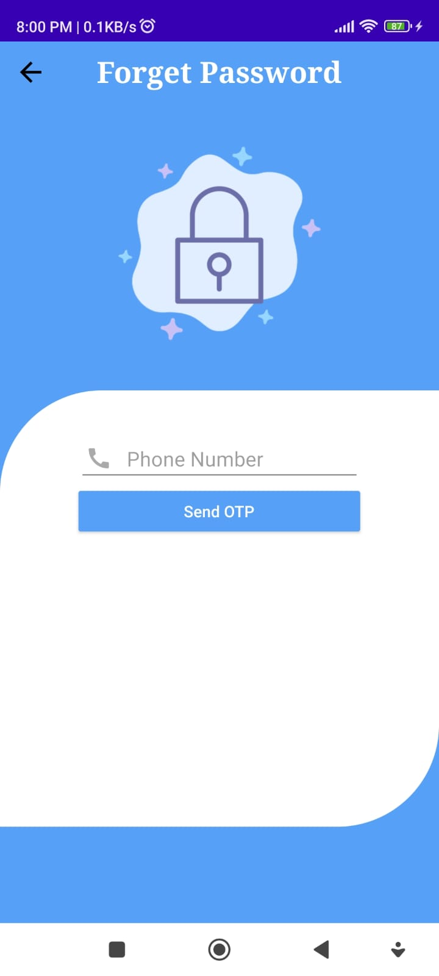
Main Admin (Principal)

Slide 34
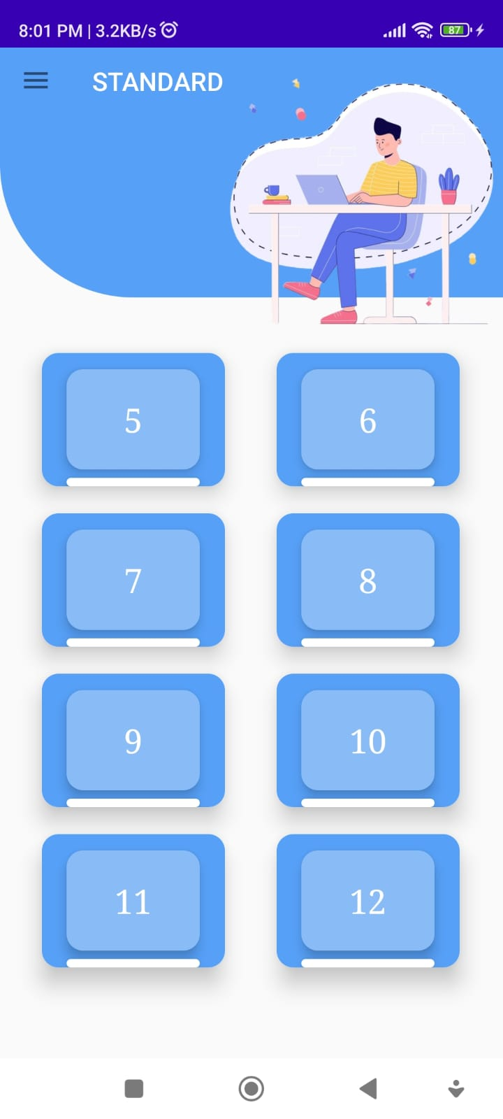
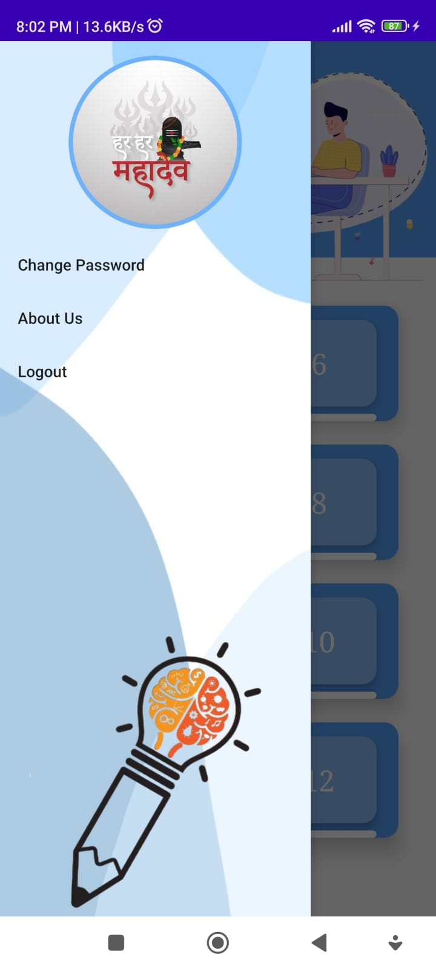
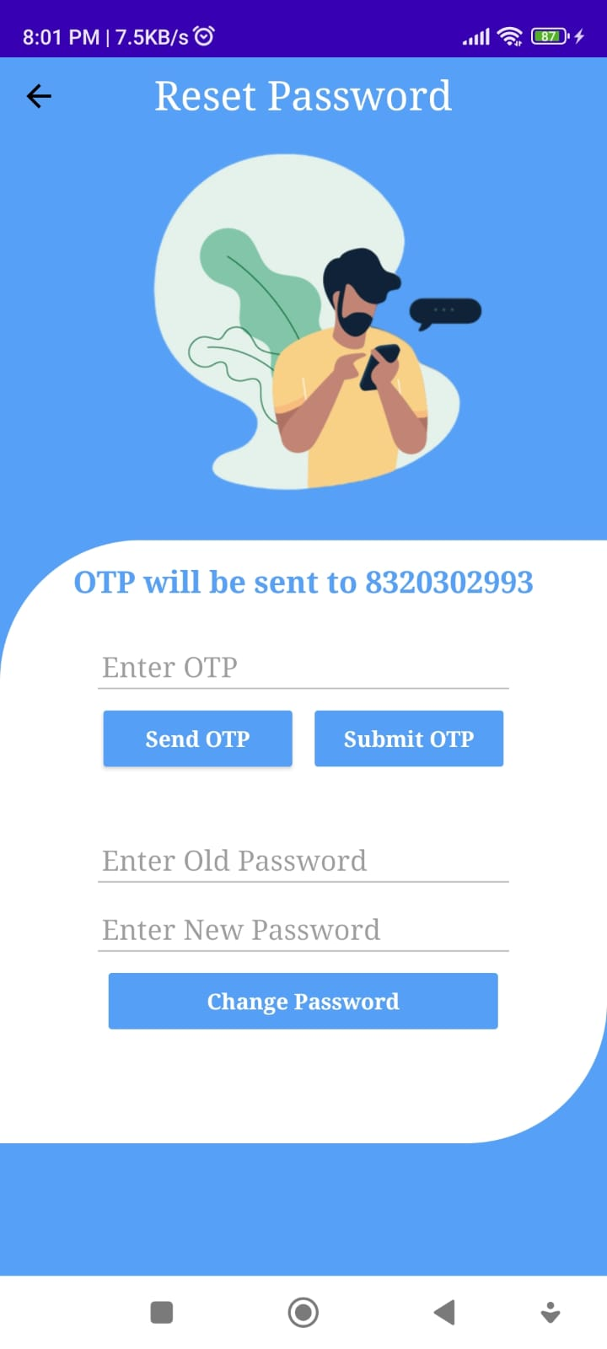

Slide 35
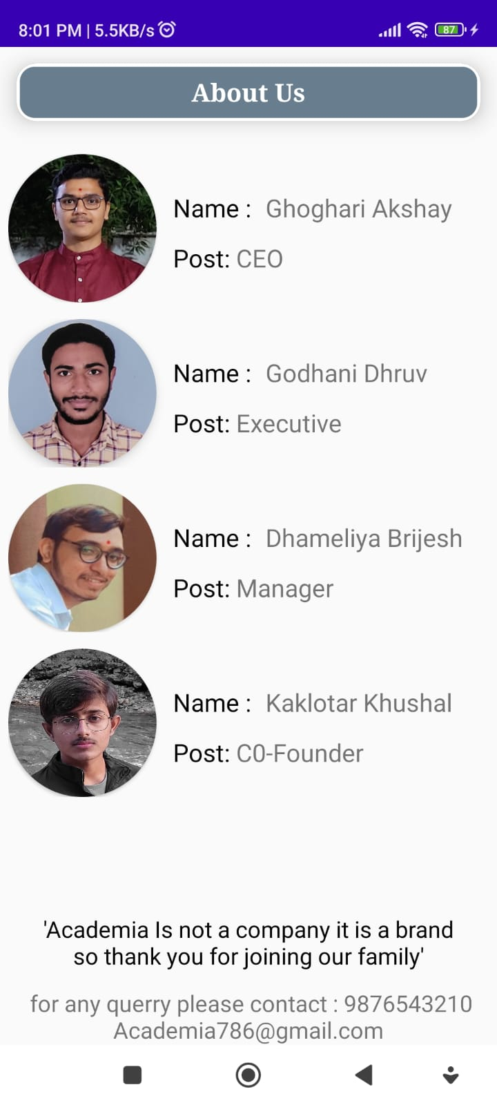
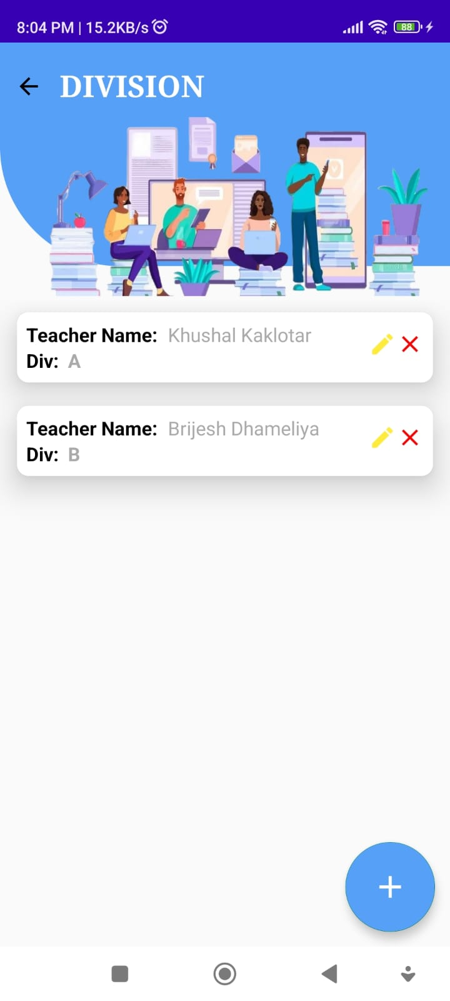
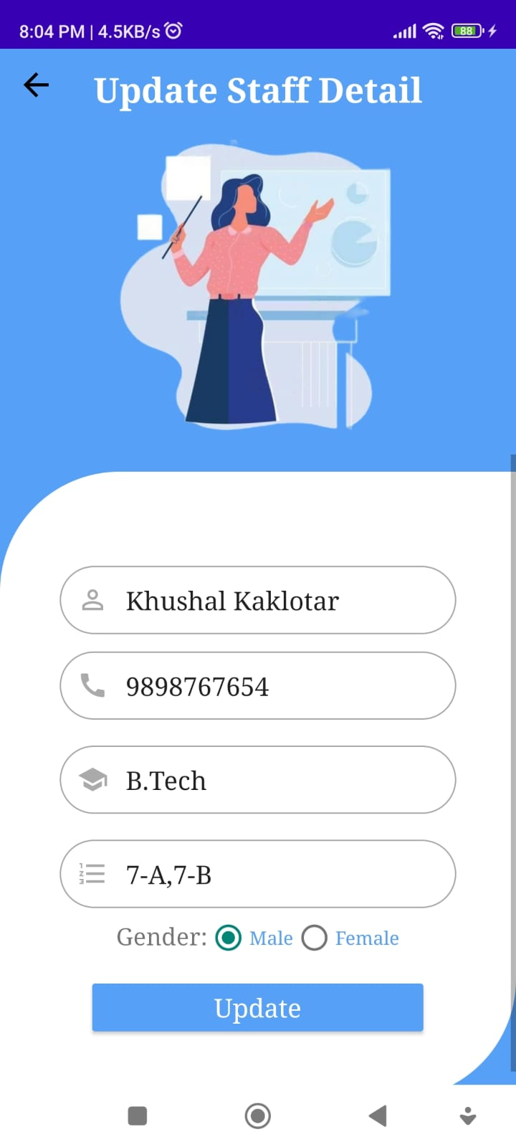

Slide 36
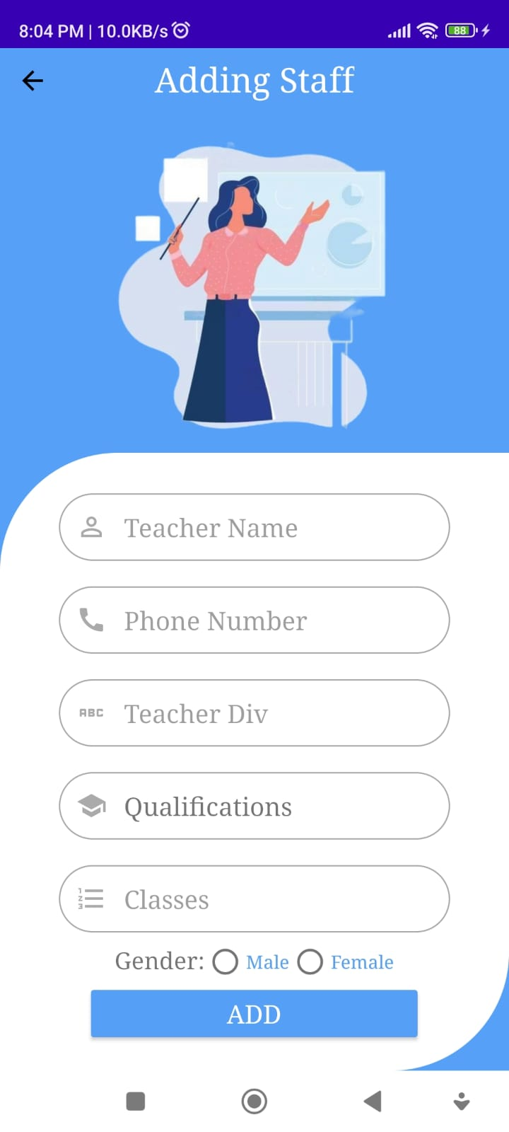
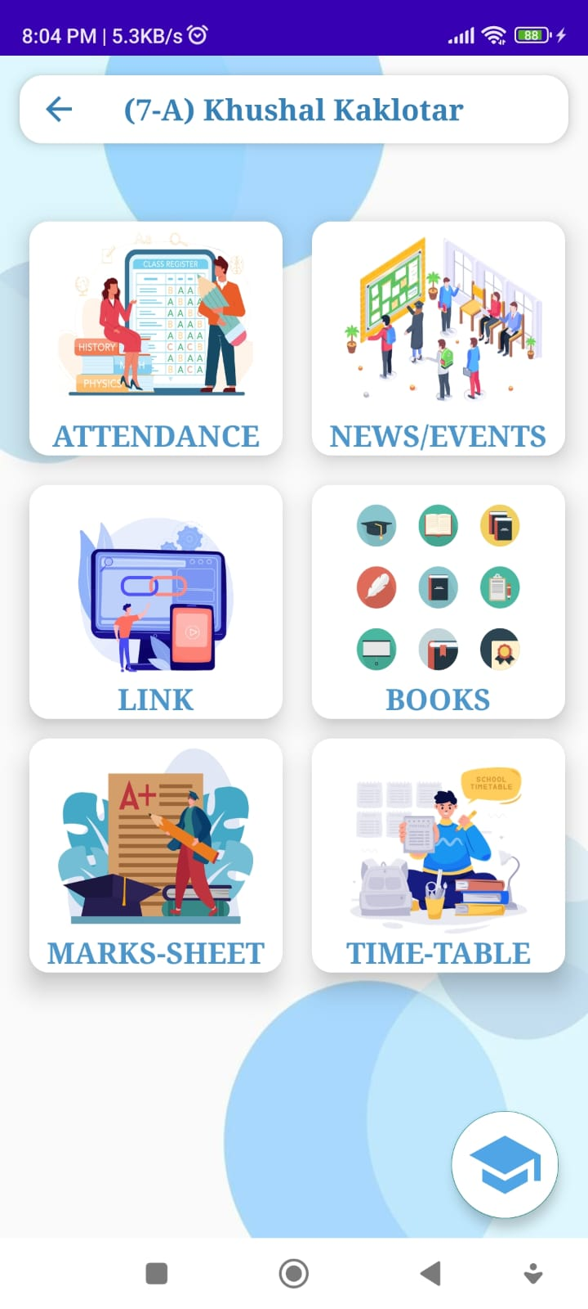
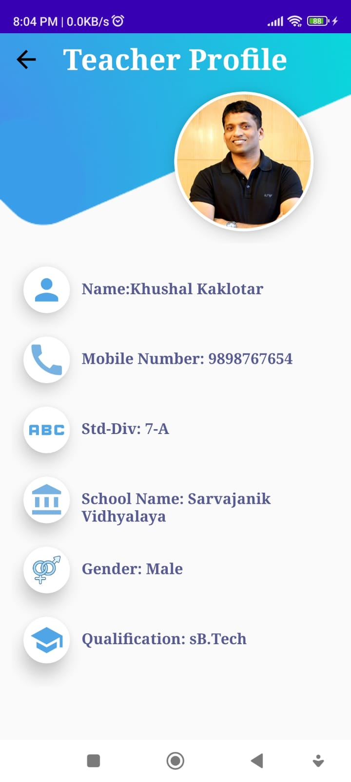

Slide 37
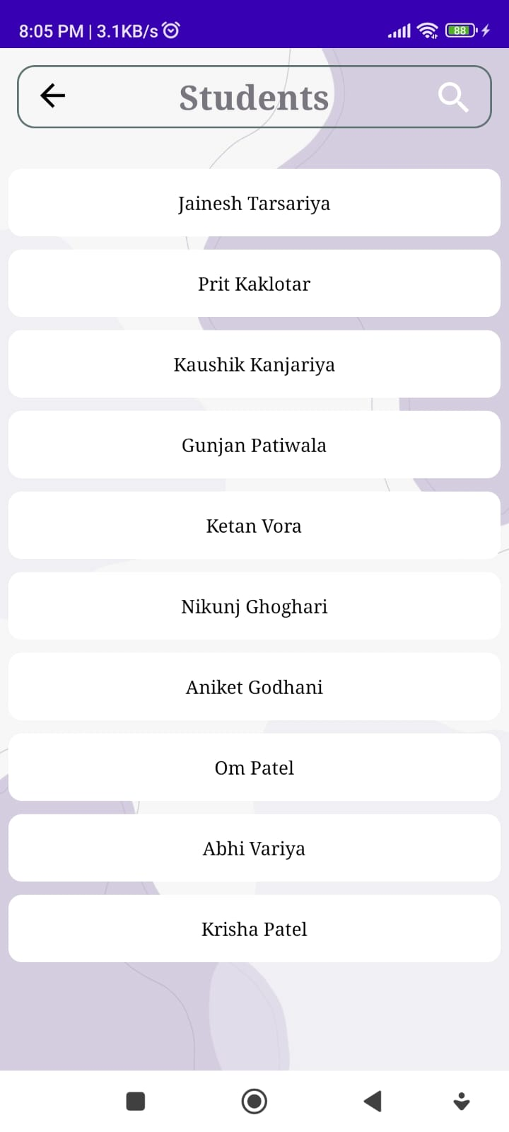
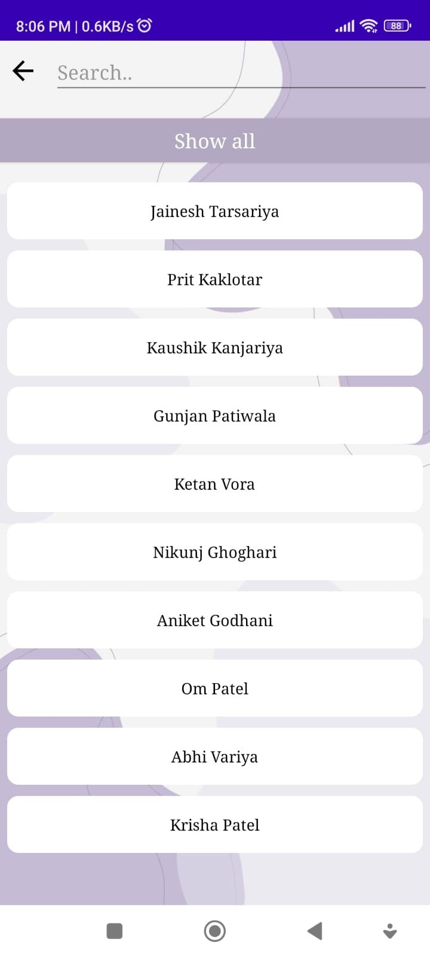
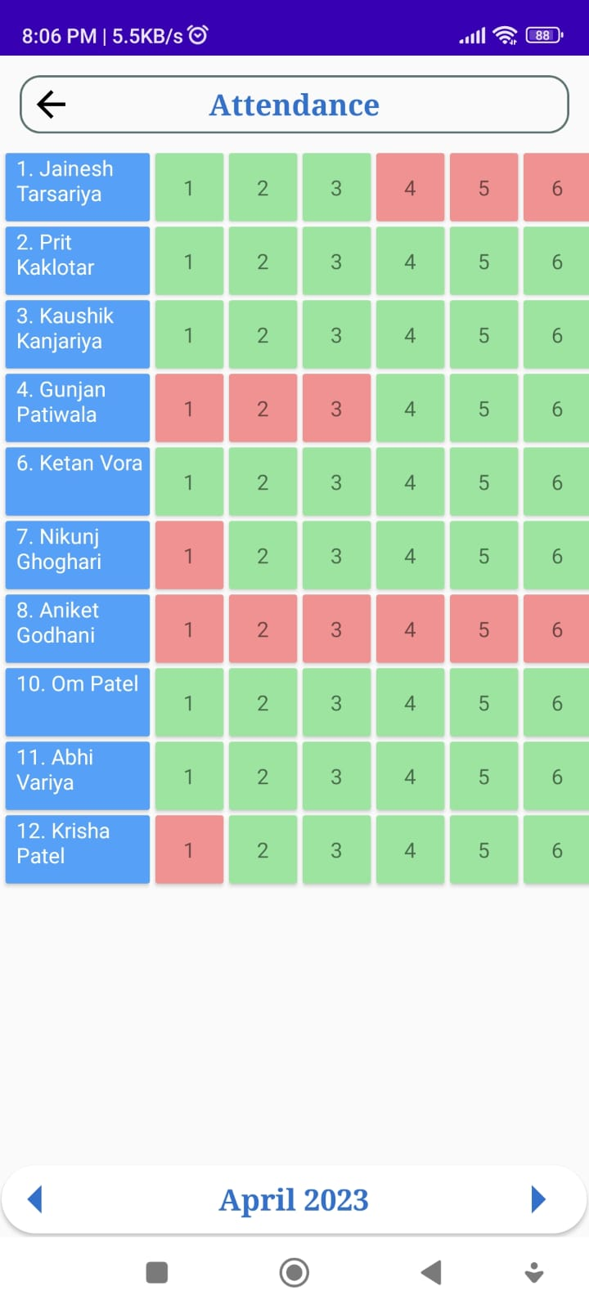

Slide 38
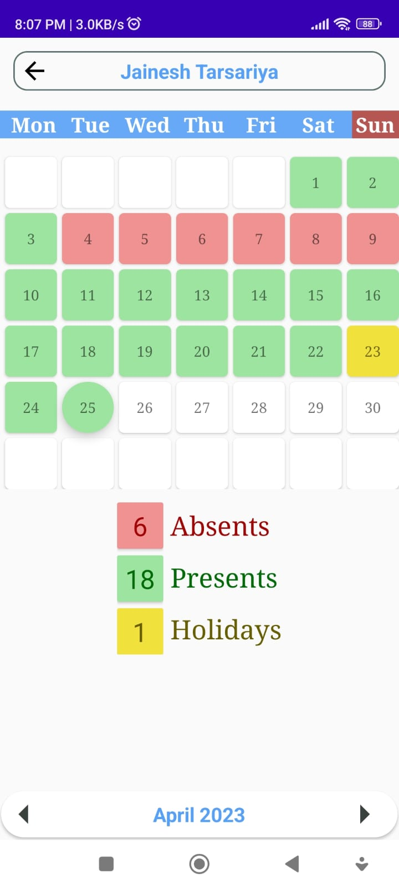
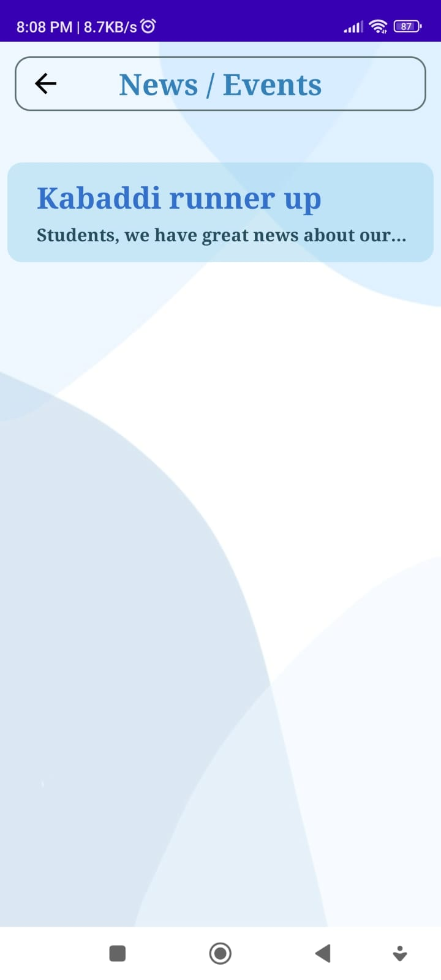
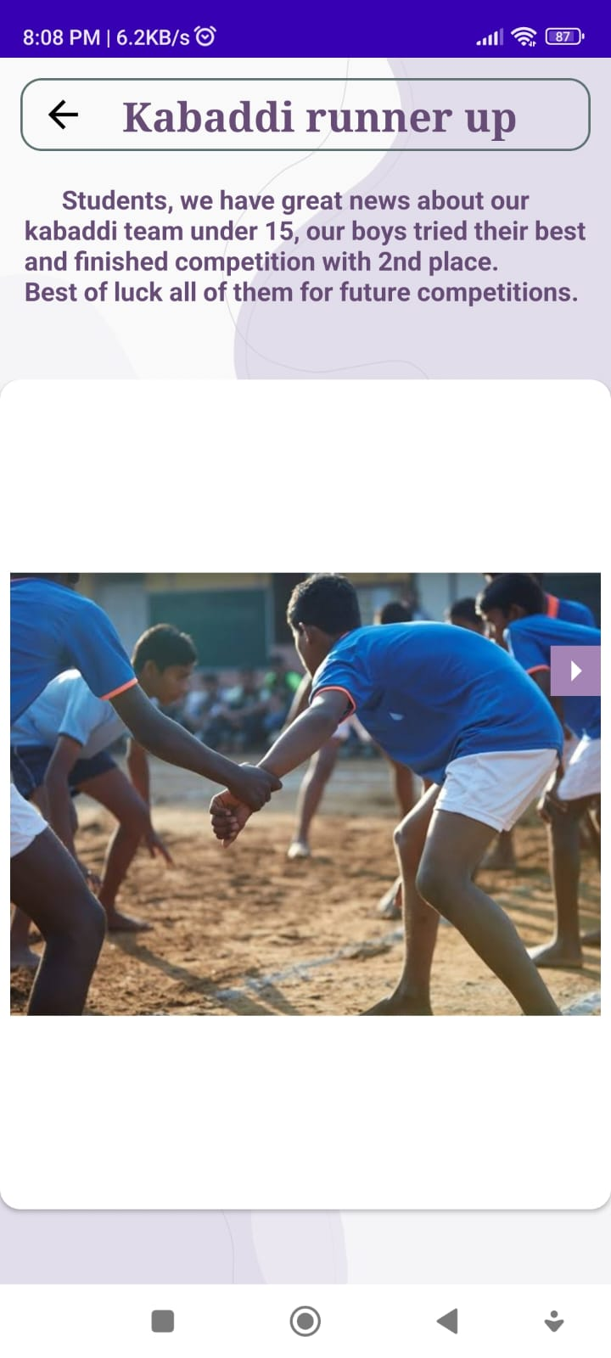

Slide 39
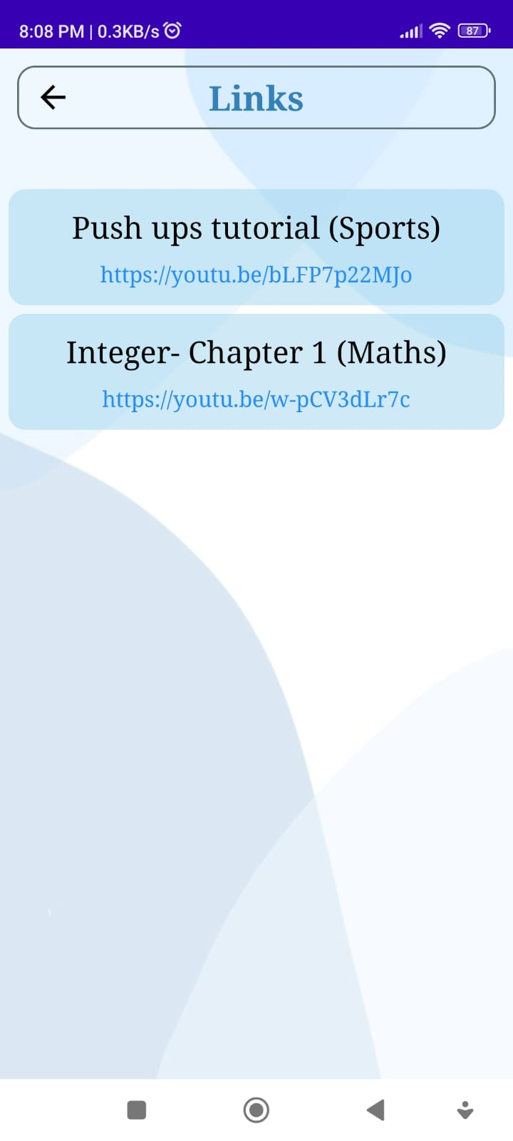
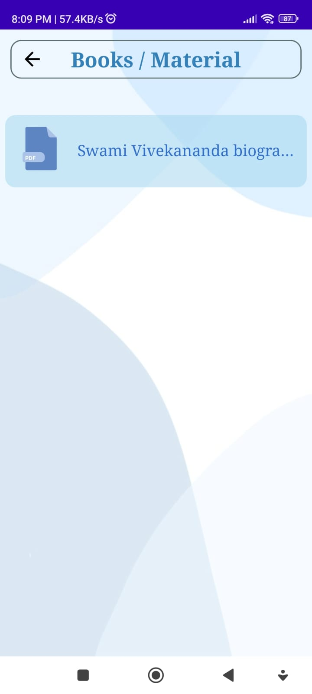
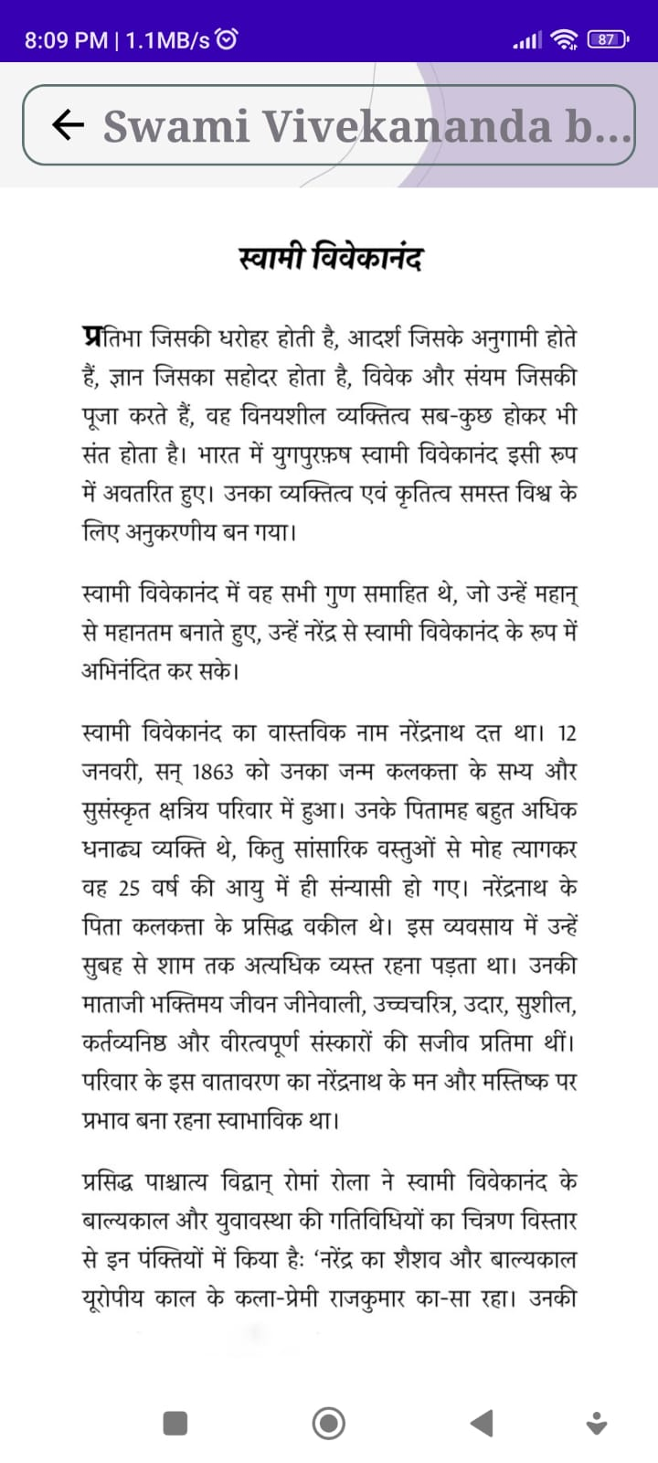

Slide 40
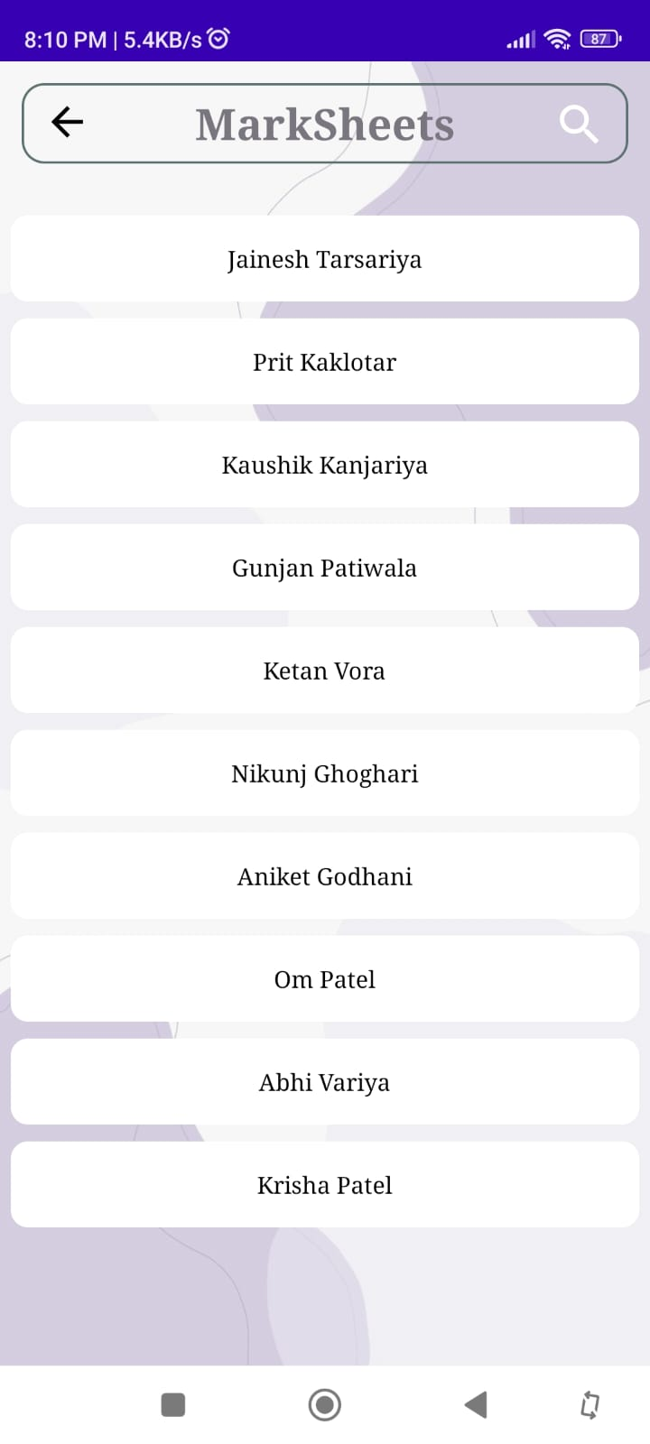
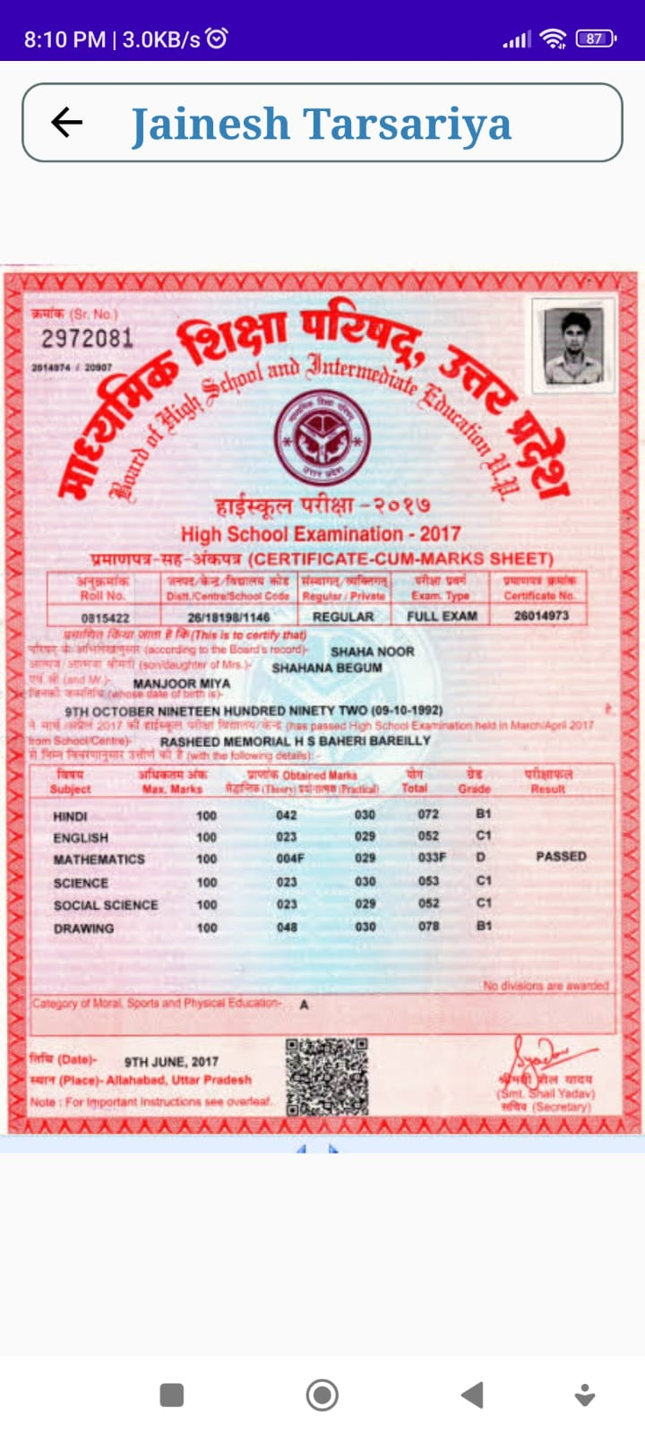
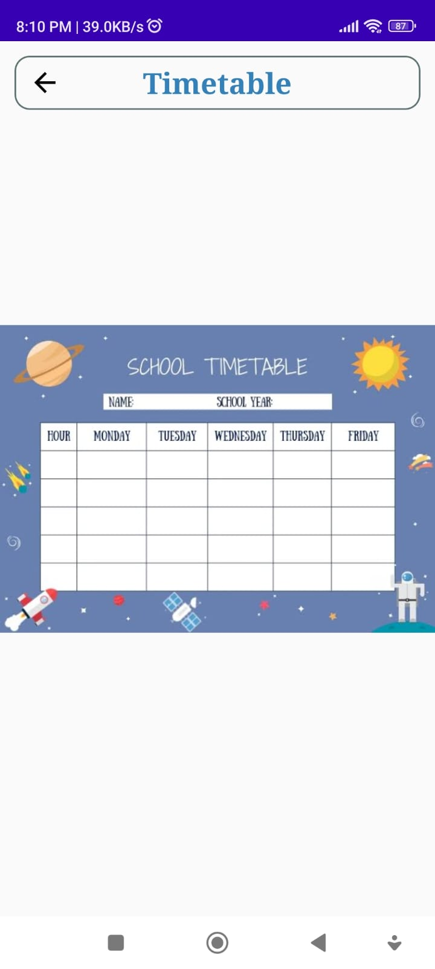

Slide 41
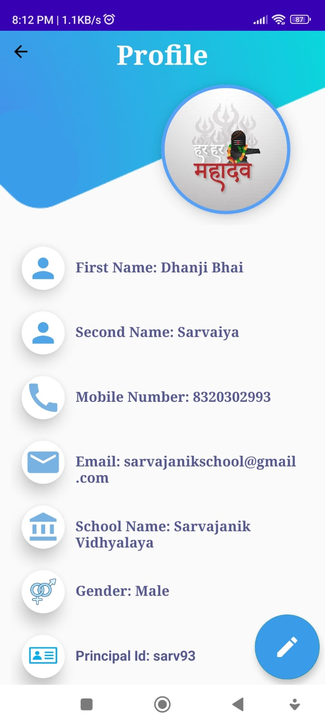
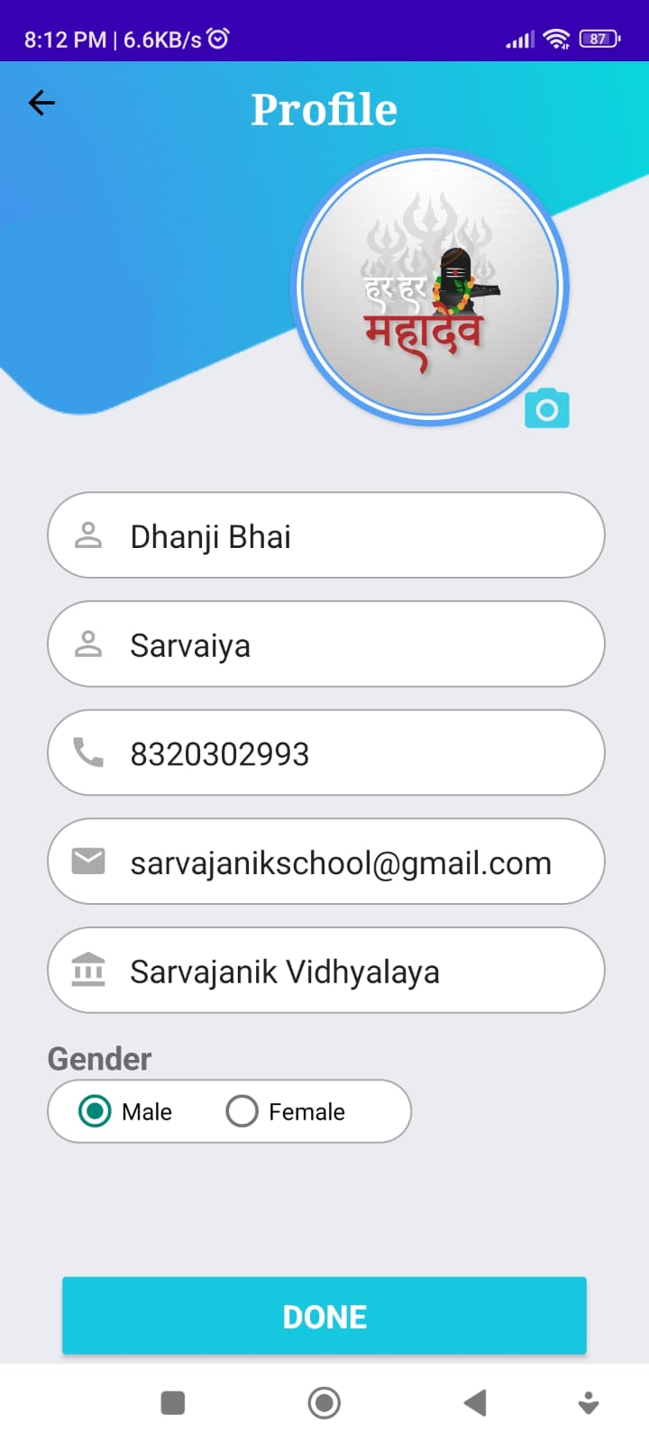

Slide 42



Admin(Teacher)

Slide 43




Slide 44




Slide 45




Slide 46




Slide 47




Slide 48




Slide 49




Slide 50




Slide 51



Slide 52



Client (Student)

Slide 53




Slide 54




Slide 55




Slide 56




Slide 57



Slide 58
References
https://www.watermarkremover.io/
https://iconscout.com/free-lotties?sort=latest
https://www.slazzer.com/upload
https://in.pinterest.com/pin/1116611301330661497/
https://iconscout.com/illustrations/attendance

Slide 59


